Slide 1
Objectives
In this session, you will learn to:
  Use comments in a source program
  Distinguish between valid and invalid identifiers
  Define the primitive types
  Define literal values for numeric and textual types
  Define the primitive and reference variable
  Declare variables of class type
  Describe variable initialization
  Distinguish between instance and local variables
  Identify boolean expressions and their requirements in control constructs
  Recognize assignment compatibility and required casts in fundamental types
  Use various loop structures in a program

Slide 2
Comments
The three permissible styles for inserting comments are:
  // comment on one line
  /* comment on one
  * or more lines
  */
  /** documentation comment
  * can also span one or more lines
  */

Slide 3
Semicolons, Blocks, and White Space
A statement is one or more lines of code terminated with a semicolon (;).
A block, sometimes called a compound statement, is a group of statements bound by opening and closing braces ({}).
A white space can be used between elements of the source code. Any amount of white space is allowed.
White space, including spaces, tabs, and new lines are used to enhance the clarity and visual appearance of the source code.

Slide 4
Identifiers
An identifier is a name given to a variable, class, or method.
Identifiers have the following characteristics:
  Can start with a Unicode letter, underscore (_), or dollar sign ($)
  Are case-sensitive and have no maximum length
The valid identifiers are:
  identifier
  userName
  user_name
  _sys_var1
  $change

Slide 5
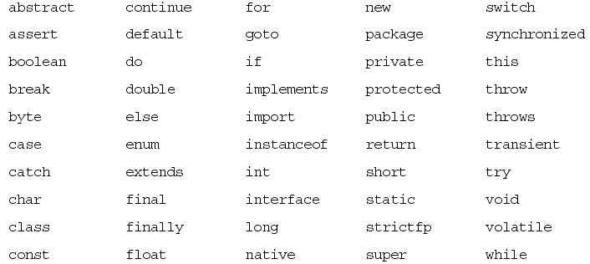
Java Programming Language Keywords
Keywords identify a data type name or program construct name.
The following figure displays keywords that are used in the Java programming language.

Slide 6
Basic Java Programming Language Types
Java programming language supports two basic data types:
  Primitive: It refers to simple values, not objects.
  Class: It is used to create objects.
The primitive data types can be considered in the following four categories:
  Logical
  Textual
  Integral
  Floating point

Slide 7
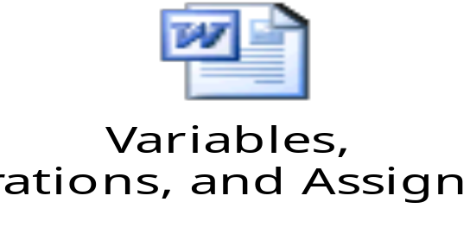
Variables, Declarations, and Assignments
Let us understand how to declare and assign variables by using the embedded document.

Slide 8
Java Reference Types
In Java technology, beyond primitive types all other data types are reference types.
Variables that refer to objects are reference variables.
A reference variable contains a handle to an object.

Slide 9
Demo: Java Reference Types
Let us see the demonstration of creating Java reference types.

Slide 10
Constructing and Initializing Objects
The objects can be constructed and initialized using the new keyword.
Calling new classname() performs the following actions:
  Memory is allocated for the object.
  Explicit attribute initialization is performed.
  A constructor is executed.
  The object reference is returned by the new operator.
  The reference to the object is assigned to a variable.

Slide 11
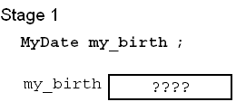
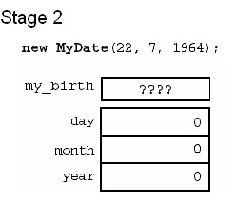
Constructing and Initializing Objects (Contd.)
The following figures display the memory allocation in various stages.

Slide 12
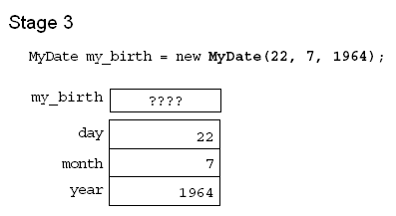
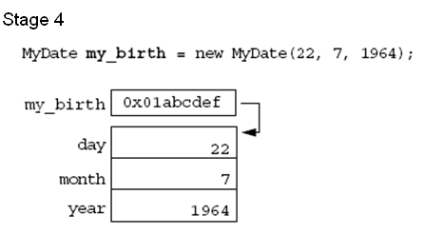
Constructing and Initializing Objects (Contd.)

Slide 13
Assigning References
In Java, a variable declared with a type of class is referred to as a reference type because it refers to a non-primitive type.
The following code snippet displays four variables (two primitives of type int and two references of type MyDate):
  int x = 7;
  int y = x;
  MyDate s = new MyDate(22, 7, 1964);
  MyDate t = s;

Slide 14
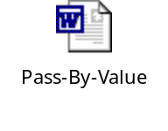
Pass-by-Value
In a single JVM, the Java programming language only passes arguments by value.
When an object instance is passed as an argument to a method, the value of the argument is a reference to the object.
The contents of the object can be changed in the called method, but the original object reference is never changed.
Let us understand the concept of pass-by-value by using the embedded document.

Slide 15

The this Reference
Two uses of the this keyword are:
  To resolve ambiguity between instance variables and parameters
  To pass the current object as a parameter to another method or constructor
Let us understand the concept of this reference by using the embedded document.

Slide 16
Java Programming Language Coding Conventions
The following table lists the coding conventions of the Java programming language.
Name | Description | Example
Packages | Package names should be nouns in lowercase. | package shipping.objects
Classes | Class names should be nouns, in mixed case, with the first letter of each word capitalized. | class AccountBook
Interfaces | Interface names should be capitalized like class names. | interface Account
Methods | Method names should be verbs, in mixed case, with the first letter in lowercase. Within each method name, capital letters separate words. | balanceAccount()
Variables | All variables should be in mixed case with a lowercase first letter. Words are separated by capital letters. | currentCustomer
Constants | Primitive constants should be all uppercase with the words separated by underscores. Object constants can use mixed-case letters. | HEAD_COUNT MAXIMUM_SIZE

Slide 17
Variables and Scope
Variables defined inside a method are called local variables, also referred to as automatic, temporary, or stack variables.
Variables defined outside a method are created when the object is constructed using the new xxx() call. They are of two types:
  Static variables: They are created when the class is loaded and continue to exist for as long as the class is loaded.
  Instance variables: They are declared without using the static keyword. They continue to exist for as long as the object exists.

Slide 18
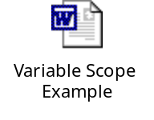
Variables and Scope (Contd.)
Let us understand the concept of variables and scope by using the embedded document.

Slide 19
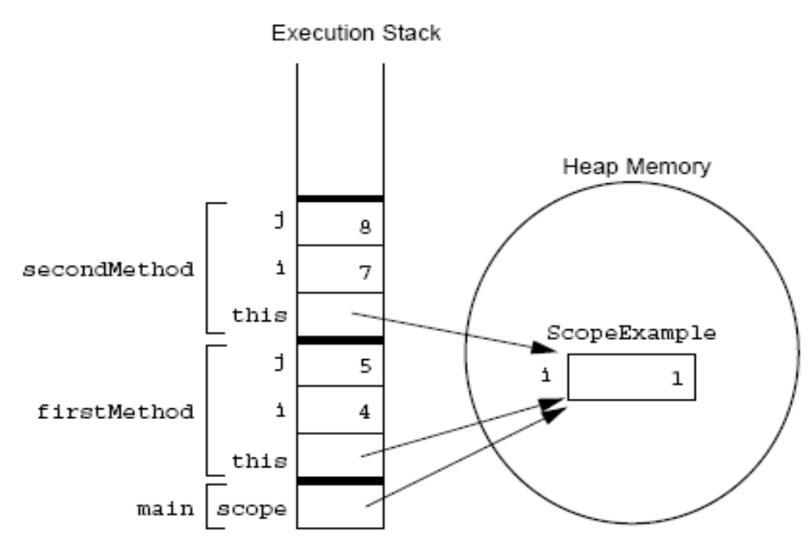
Variables and Scope (Contd.)
The following figure displays the scope of variables’ memory allocation given in the preceding code.

Slide 20
Variable Initialization
  It is necessary to initialize the variables before using then in the program.
  Java forces the compiler to assign a value for local variables.
  Java forces the complier to assign the default values for primitive and reference instance variables.

Slide 21
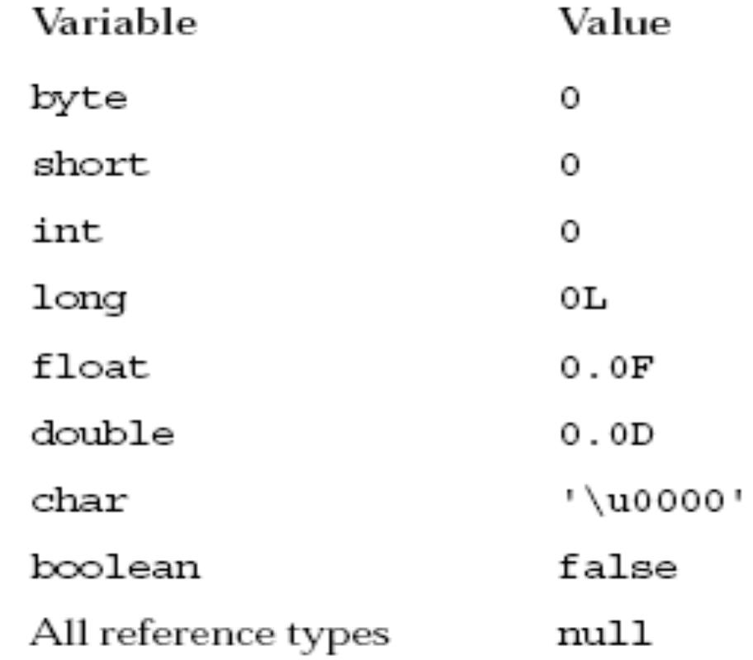
Variable Initialization (Contd.)
  The following figure displays the default values of primitive types.

Slide 22
Initialization Before Use Principle
Local variables must be initialized manually before use.
The compiler flags an error if it can determine a condition where a variable can be used before being initialized.
The following code snippet displays the importance of variable initialization:
  public void doComputation() {
  int x = (int)(Math.random() * 100);
  int y;
  int z;
  if (x > 50) {
  y = 9;
  }
  z = y + x; // Possible use before initialization
  }

Slide 23
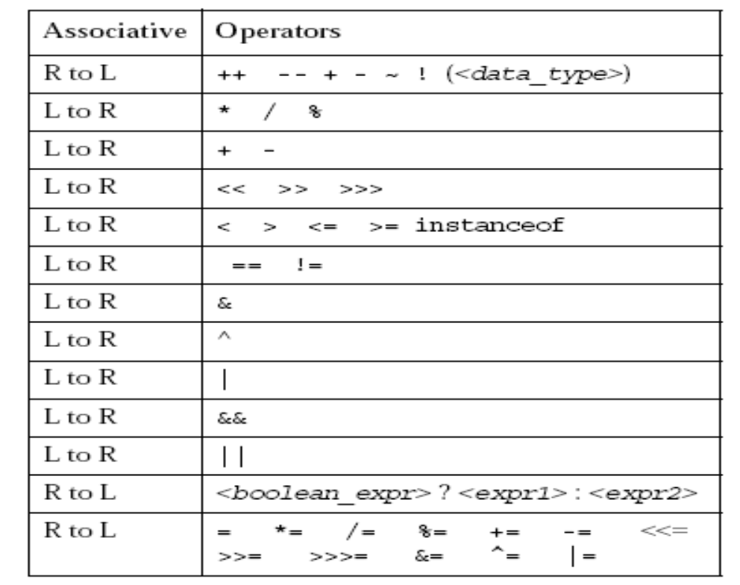
Operator Precedence
The following figure displays the operators in order of precedence (L to R means left-to-right associative; R to L means right-to-left associative).

Slide 24
Logical Operators
Relational and logical operators return a boolean result.
The value 0 is not interpreted automatically as false and non-zero values are not interpreted automatically as true.
The following code snippet displays the boolean result interpretation of the relational and logical operators:
  int i = 1;
  if (i) // generates a compile error
  if (i != 0) // Correct
The boolean operators supported are !, &, ^, and | for the algebraic Boolean operations NOT, AND, XOR, and OR, respectively. Each of these returns a boolean result.
The operators && (AND) and || (OR) are the short-circuit equivalents of the operators & and |.

Slide 25
Logical Operators (Contd.)
The operators && (AND) and || (OR) are the short-circuit equivalents of the operators & and |.
The following code snippet displays the interpretation of the
short-circuit logical expressions:
  MyDate d = reservation.getDepartureDate();
  if ((d != null) && (d.day > 31)) {
  // do something with d
  }

Slide 26
Bitwise Logical Operators
Bit manipulation operations, including logical and shift operations, perform low-level operations directly on the binary representations used in integers.
The Java programming language supports bitwise operations on integral data types.
These are represented as the operators ~, &, ^, and | for the bitwise operations of NOT (bitwise complement), bitwise AND, bitwise XOR, and bitwise OR, respectively.

Slide 27
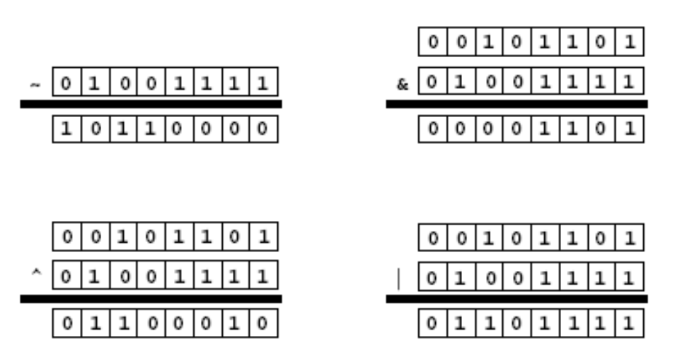
Bitwise Logical Operators (Contd.)
The following figure displays the bitwise operators on
byte-sized binary numbers.

Slide 28
Right-Shift Operators >> and >>>
The Java programming language provides two right-shift operators.
The operator >> performs an arithmetic or signed right shift. The result of this shift is that the first operand is divided by 2 raised to the number of times specified by the second operand.
The >> operator results in the sign bit being copied during the shift.
The logical or unsigned right shift operator >>> works on the bit pattern rather than the arithmetic meaning of a value and always places 0s in the most significant bits.

Slide 29

Right-Shift Operators >> and >>> (Contd.)
The following figure displays the usage of right shift operators.

Slide 30

Left-Shift Operator <<
The result of the left shift is that the first operand is multiplied by two raised to the number specified by the second operand.
The following figure displays the usage of left shift operators.

Slide 31

String Concatenation With +
The + operator performs a concatenation of String objects, producing a new String.
If either argument of the + operator is a String object, then the other argument is converted to a String object.
The following figure displays the concatenation of String objects.

Slide 32
Casting
Casting means assigning a value of one type to a variable of another type.
If the two types are compatible, the Java software performs the conversion automatically.
Where information might be lost in an assignment, the compiler requires that you confirm the assignment with a cast.

Slide 33
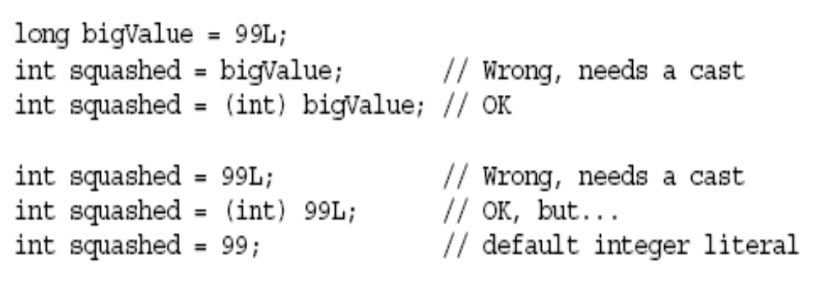
Casting (Contd.)
The following figure displays the casting done on different variable types.

Slide 34
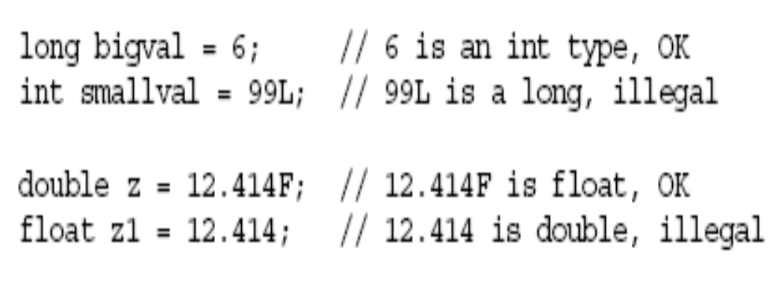
Promotion and Casting of Expressions
Variables are promoted automatically to a longer form (such as int to long).
Expression is assignment-compatible if the variable type is at least as large (the same number of bits) as the expression type.
The following figure displays the promotion and casting of expressions.

Slide 35
Branching Statements
Conditional statements enable the selective execution of portions of the program according to the value of some expressions.
The Java programming language supports the if and switch statements for two-way and multiple-way branching, respectively.

Slide 36
Simple if, else Statements
The basic syntax for an if statement is:
  if ( <boolean_expression> )
  <statement_or_block>

Slide 37
Complex if, else Statements
An if-else statement is used, if an else clause is required.
The basic syntax for an if-else statement is:
  if ( <boolean_expression> )
  <statement_or_block>
  else
  <statement_or_block>

Slide 38
The switch Statement
The syntax of the switch statement is:
  switch ( <expression> ) {
  case <constant1>:
  <statement_or_block>*
  [break;]
  case <constant2>:
  <statement_or_block>*
  [break;]
  default:
  <statement_or_block>*
  [break;]
  }

Slide 39
Looping Statements
Looping statements enable you to execute block of statements repeatedly.
Java programming language supports three types of loop constructs:
  The for loop
  The while loop
  The do/while loop

Slide 40
Demo: Looping Statements
Let us see the demonstration of using loops in Java.

Slide 41
Summary
In this session, you learned that:
  An identifier is a name given to a variable, class, or method. An identifier can not be a keyword.
  Java technology keywords identify a data type name or program construct name.
  The Java programming language provides class and primitive data types.
  An object can be constructed using the keyword new.
  The Java programming language passes arguments only by value.
  The this keyword is used to resolve ambiguity between instance variables and parameters.
  There are two types of variables, primitive type and reference type.

Slide 42
Summary (Contd.)
  Casting means assigning a value of one type to a variable of another type.
  Conditional statements enable the selective execution of portions of the program according to the value of some expressions.

